Slide 1
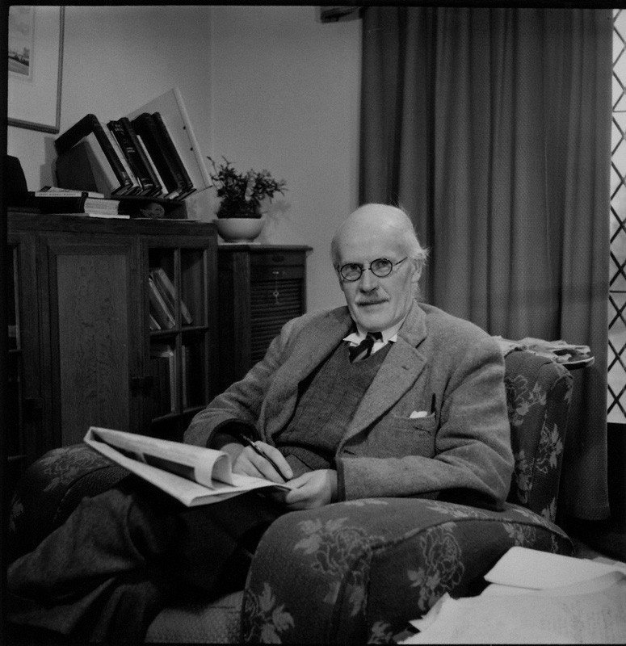

Slide 2
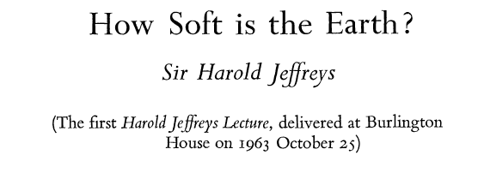
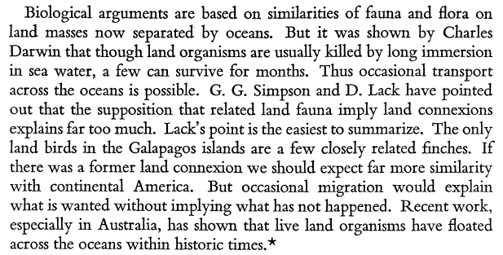

Slide 4
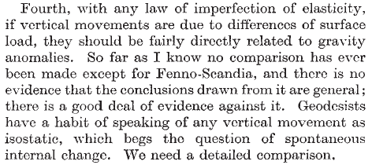

Slide 5
- Beloussov (1970)
- Galperin and Kosminskaya (1964)
- Lyustikh (1967)

Slide 6
